Slide 1
UBER SUPPLY-DEMAND GAP CASE STUDY
Analyst: Vijayanand Narayanan

Slide 2
Abstract
Business Brief
Drivers are cancelling trips and there is non-availability of cars for customers
Both these issues affect customers
Uber faces loss of revenue
Objectives
Carry out analysis of Uber’s supply and demand using data provided.
Aim of the analysis is to:
Perform a supply and demand gap in the city and airport for the given data
Identify root cause of the problem of cancellation by drivers and non-availability of cars
Recommend ways to improve the situation and increase revenue for Uber

Slide 3
Problem Solving Methodology
Exploratory Data Analysis (EDA) approach using Data cleaning, Univariate, Bivariate and Derived metrics was used to identify hidden patterns in the data set.
Data Issues Considered:
Driver.id and Drop.timestamp had NA values
Request.timestamp and Drop.timestamp columns were not in the date time format
Request.timestamp and Drop.timestamp values had inconsistent “/” and “–” as separators for date

Slide 4
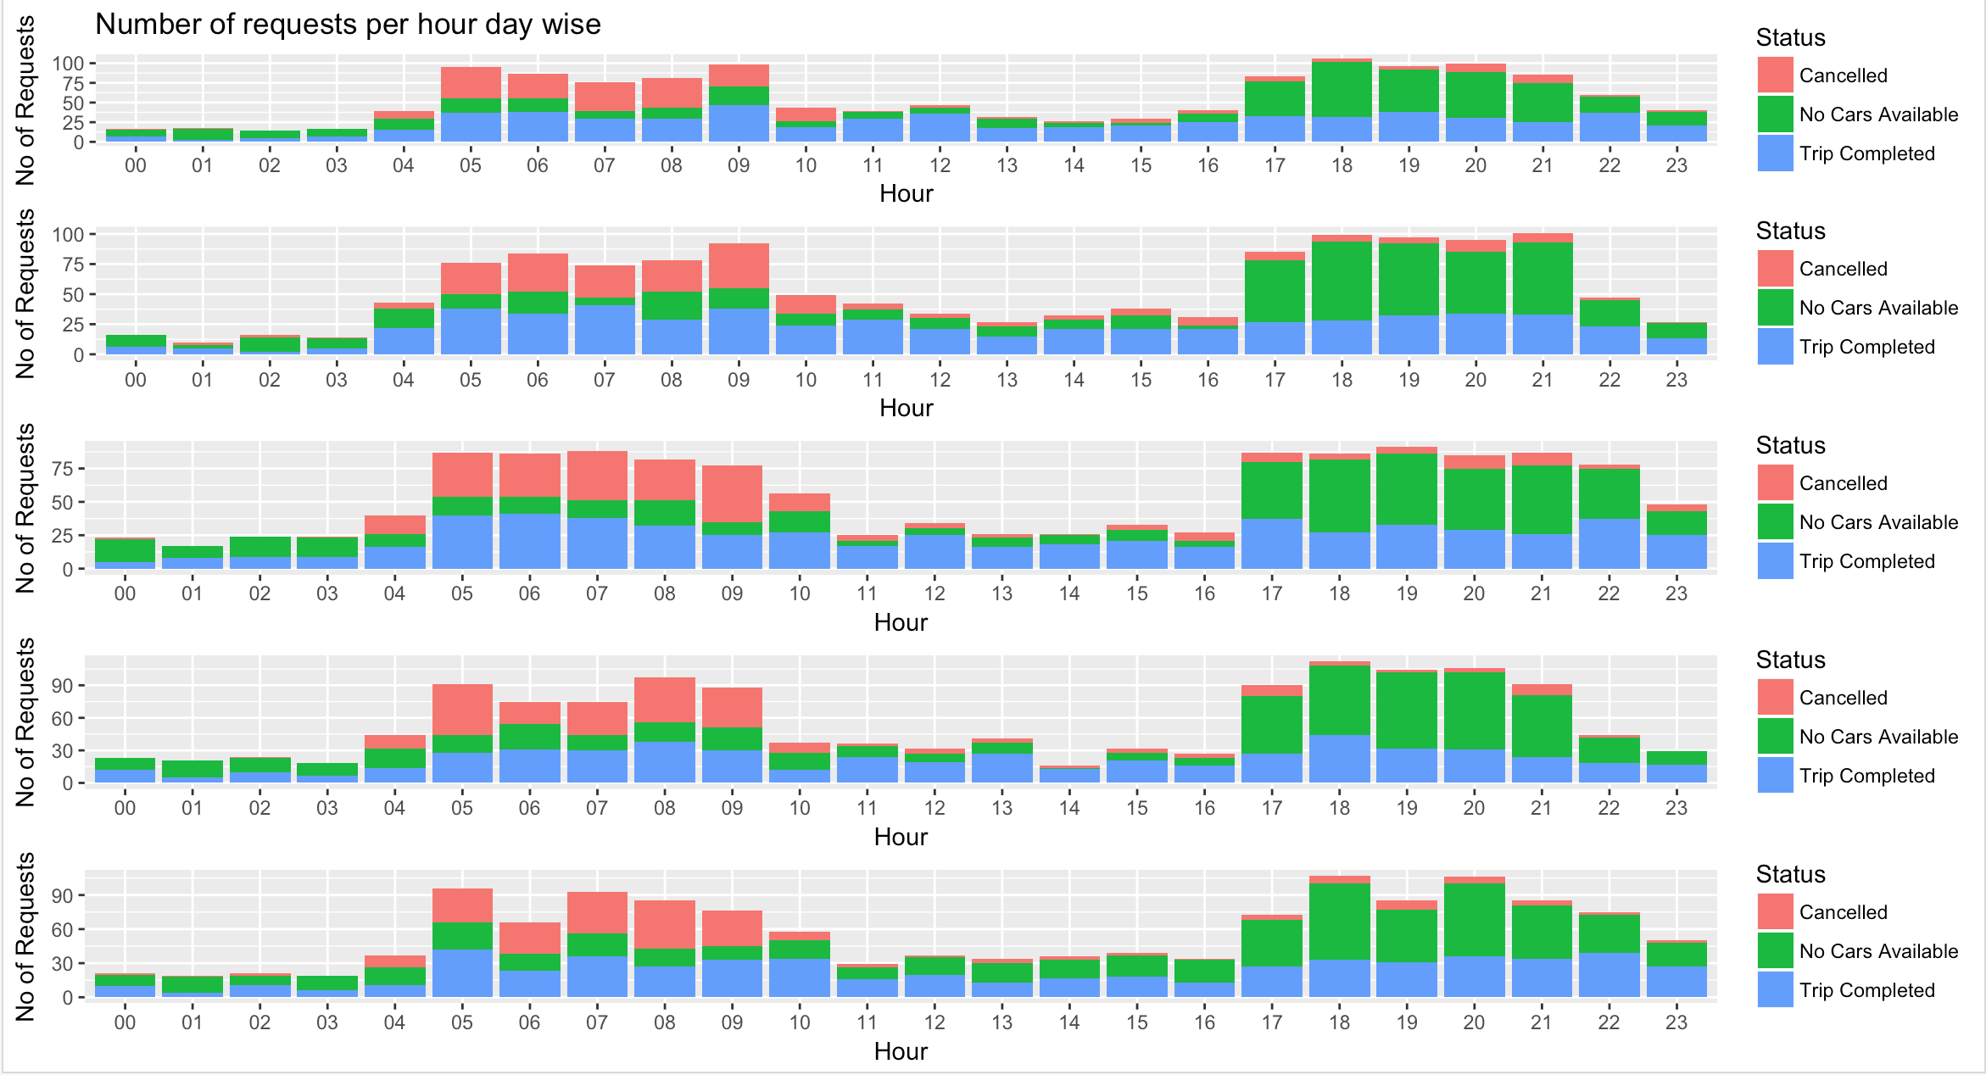
Analysis of Number of Requests by Status
High requests between 5 am and 9 am and between 5 pm and 9 pm. This pattern is similar for all days.

Slide 5
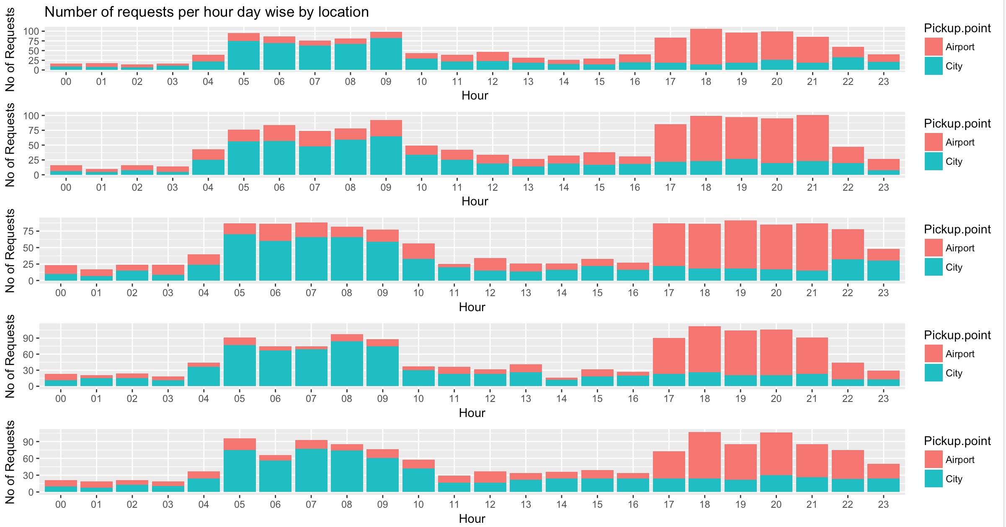
Analysis of Number of Requests by Location
City has more demand between 5 am and 9 am and Airport has more demand between 5 pm and 9 pm. This pattern is similar for all days.

Slide 6
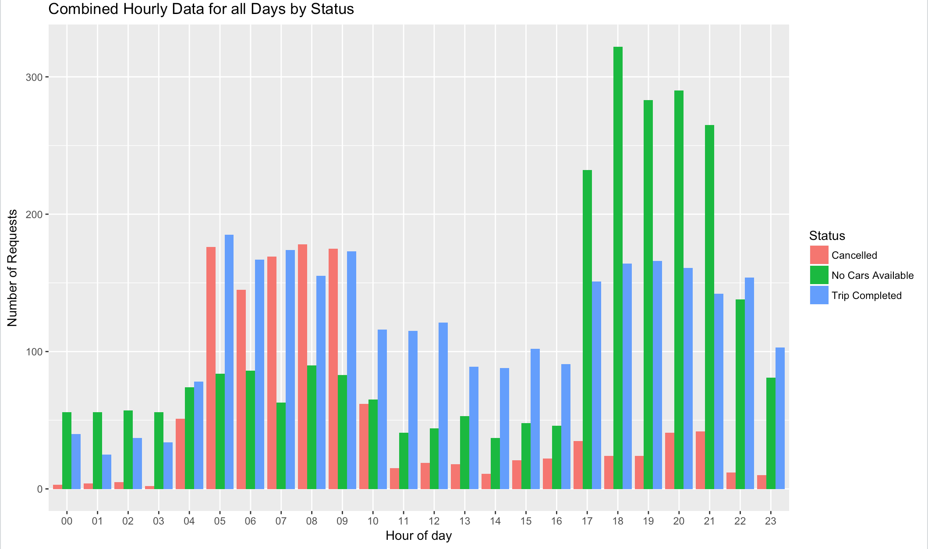
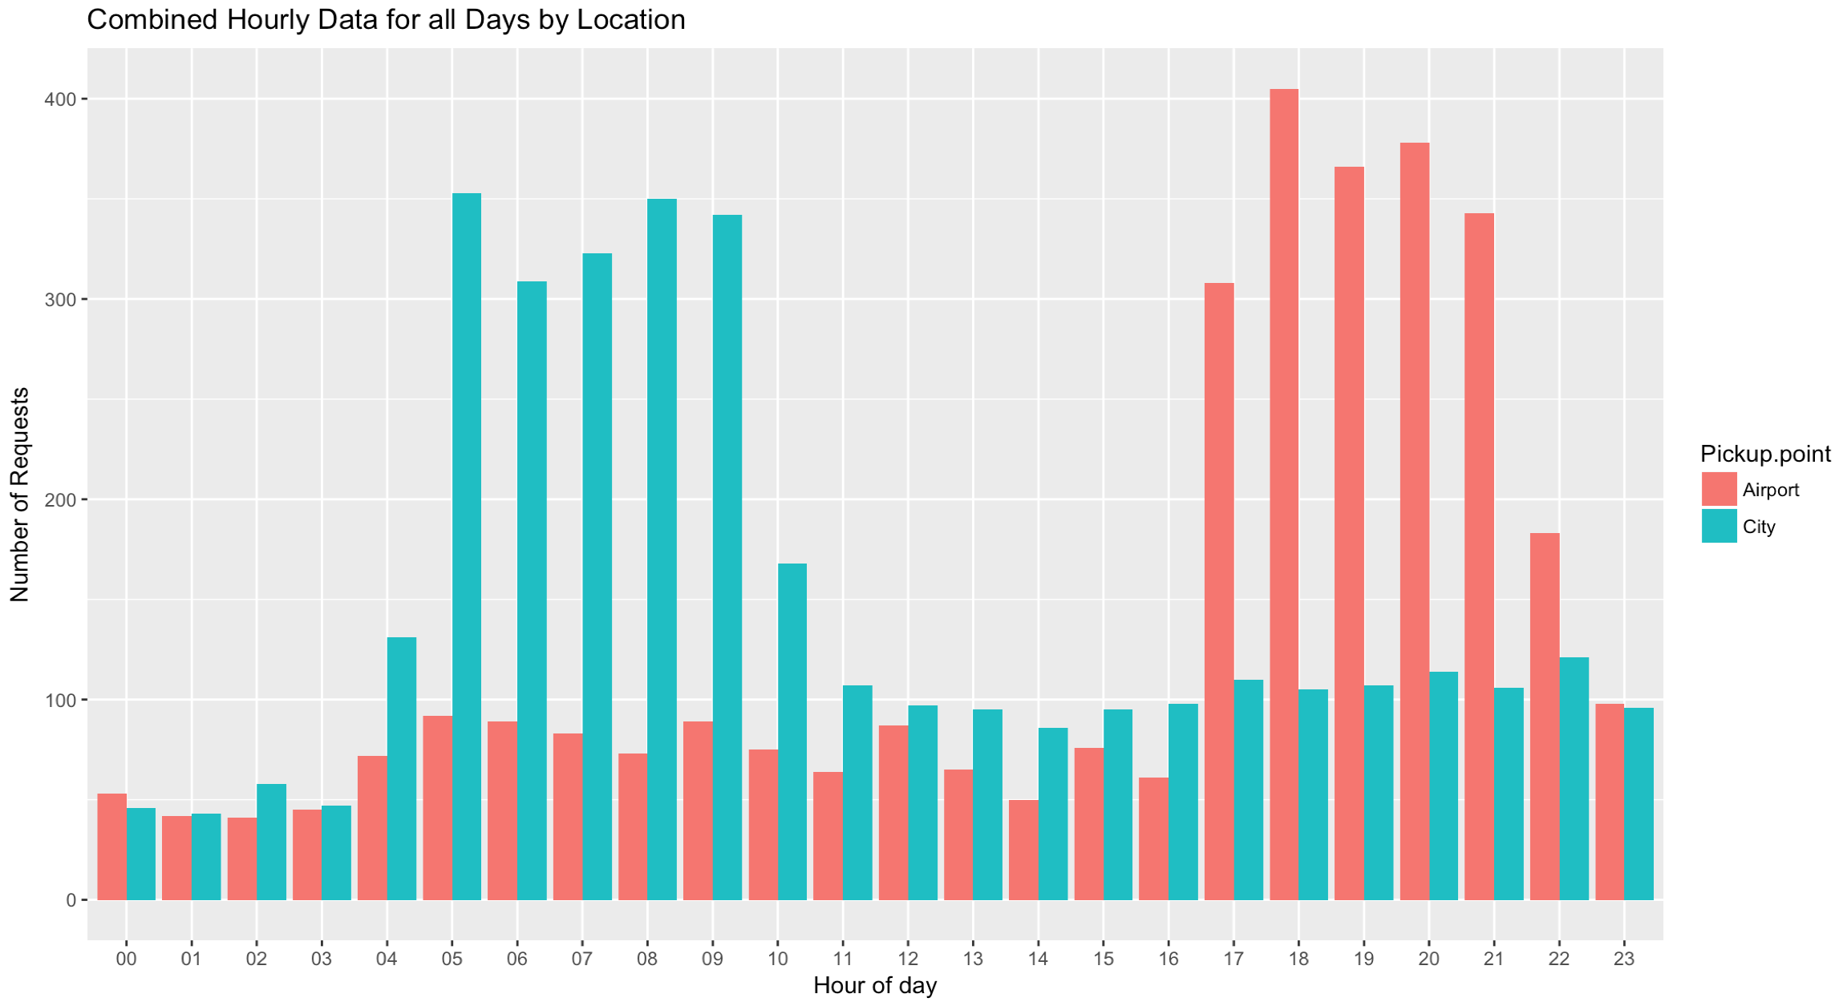
Analysis of Requests for All Days
Cancellations are high in the morning and more cars are unavailable in the evening
City has high demand in the morning and Airport has high demand in the evening

Slide 7
Group Requests by Time slots
Requests are grouped into the following categories based on time
Time | Category
12 AM – 05 AM | Early Morning
05 AM – 10 AM | Morning
10 AM – 05 PM | Day
05 PM – 10 PM | Evening
10 PM – 12 AM | Night

Slide 8
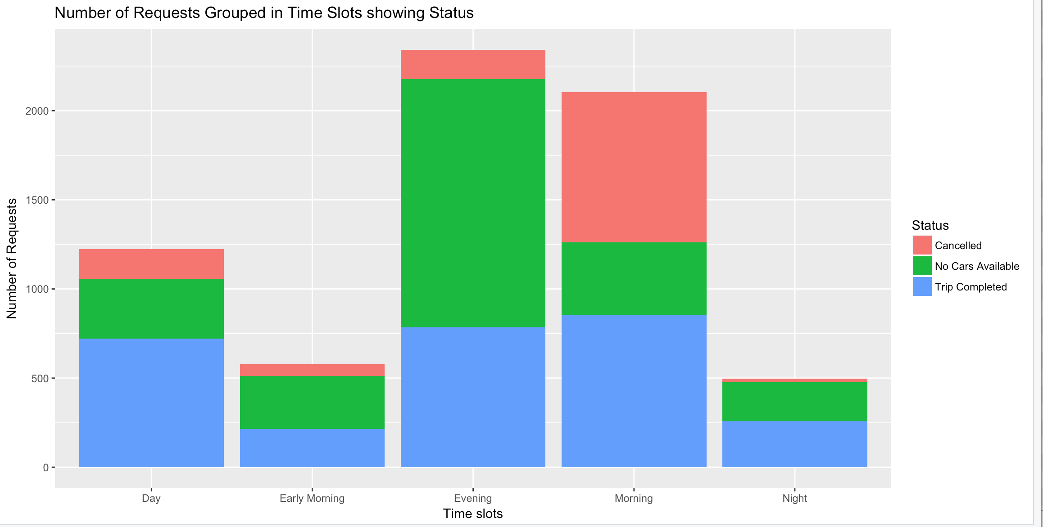
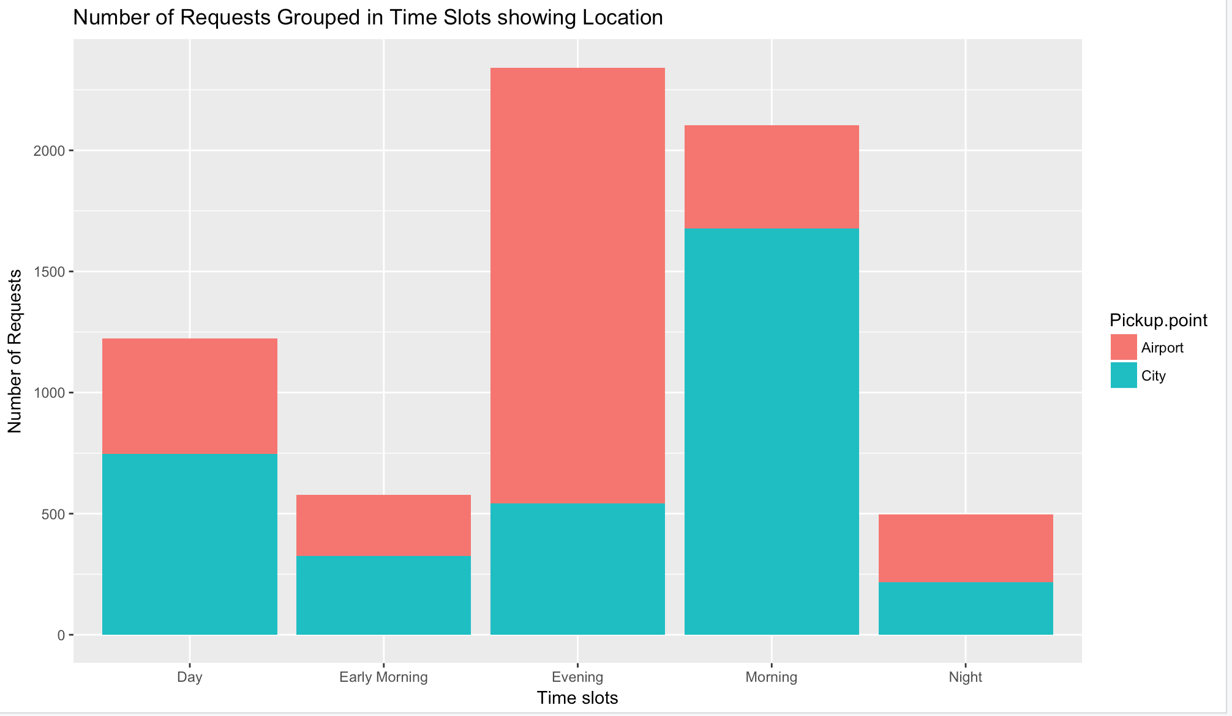
Most Problematic Types of Requests
From the graphs it can be seen that there are
two issues:
There are high Cancellations in the morning time slot at the City
There is High non availability of cars in the evening time slot at the Airport

Slide 9
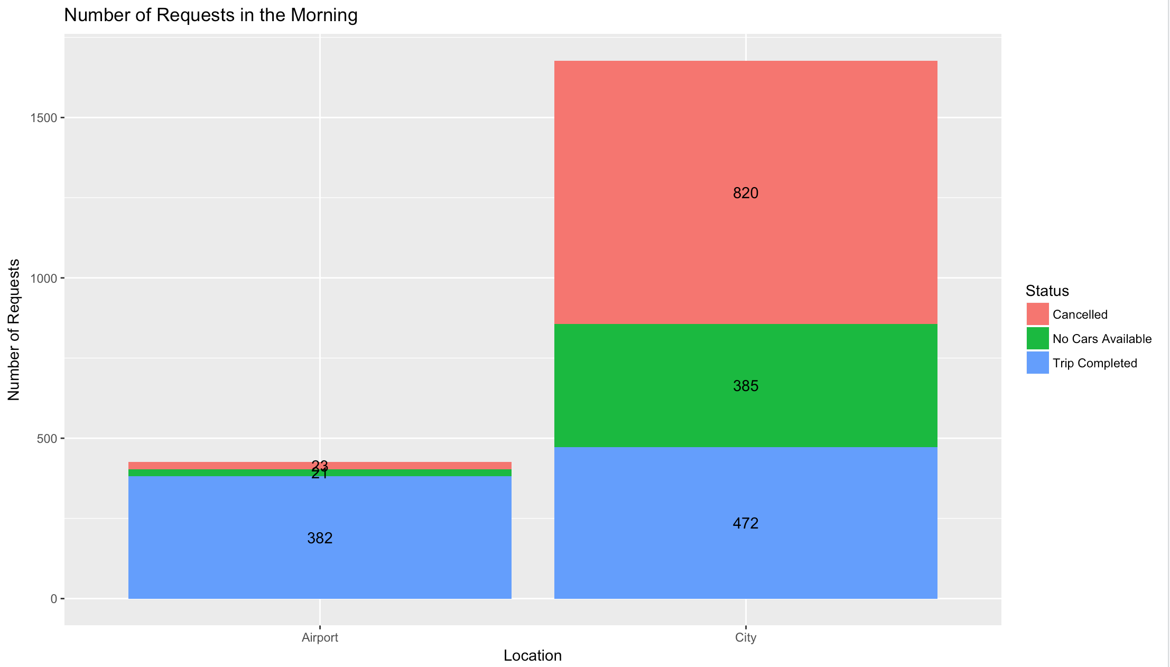
Supply Demand at the City in the Morning
Supply at the City is 472 whilst demand is 1677 (472+385+820)
Supply Demand Gap in City is 1205 (1677-472)
49% of the trips in the city were Cancelled in the Morning
City is not in good health as there is more demand and less supply

Slide 10
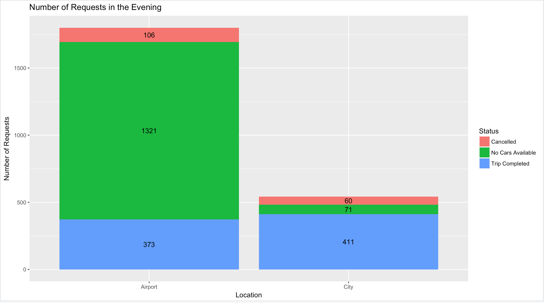
Supply Demand at the Airport in the Evening
Supply at the Airport is 373 whilst demand is 1800 (373+1321+106)
Supply Demand Gap at the Airport is 1427 (1800-373)
74% of the trips at the Airport in the Evening had No cars available
Airport is not in good health as there is more demand and less supply

Slide 11
Reasons for Supply Demand Gap
There is a huge supply demand gap in the City with nearly 50% of the trips to the airport being cancelled by the drivers in the morning. Some reasons could be,
It might take long for the driver to get to the airport incurring more gas mileage which might not make economical sense for the driver
Drivers could be facing an idle time at the airport. This might be because of flight patterns where less flights arrive into the terminal at that time and the drivers have no trips back to the city. Idle time at the airport is loss of revenue for the drivers when they could be making money if driving in the city at that time

Slide 12
Reasons for Supply Demand Gap
Similarly, 74% of the trips from the airport in the evenings have no cars available. Some reasons could be,
There might not be enough flights taking off from this airport at this time in the evening and hence not enough drivers have trips from the city to the airport. This causes a shortage in the organic supply of cars at the airport in the evening
Also, most drivers end the working day by evening and return home. So, it might be possible that they are unwilling to make trips to the airport in the evening

Slide 13
Recommendations to Uber
Reduce cancellations from City to Airport in the morning
Drivers can be provided incentives to make trips to airports
Uber could share gas expenses with the drivers for airport trips
Reduce driver’s idle time at the airport by increasing demand through attractive offers and promotions for customers
Increase availability of cars at the Airport in the evening
Uber can proactively alert the drivers around the airport area about demand from the airport to city
Drivers can be provided incentives to make trips from airport to city
Reduces fares for customers so that shared trips can be made to the city

